Slide 1
Deployment and Operations for Software Engineers 2nd Ed
Chapter 11 – Deployment pipeline 2

Slide 2
Outline
Development environment
Integration environment
Staging environment

Slide 3
Development environment
You are working on a single module.
It may represent a new service
It may be the maintenance of an existing service.
You will interact with the version control system and an IDE
There is a branch of the version control system where you keep the code you are developing.
It may be newly created
It may have checked out code from an existing branch.
Either one of these activities is the trigger to execute the create step

Slide 4
Development environment – create
Create loads the VM or container with the software you need for your module, which includes operating system, libraries, and dependent modules.
Your IDE should be set up to use this environment as the destination for its activities:
When you compile your new or changed code into an executable form, the IDE should place the executable artifacts into the development environment so you can begin testing.

Slide 5
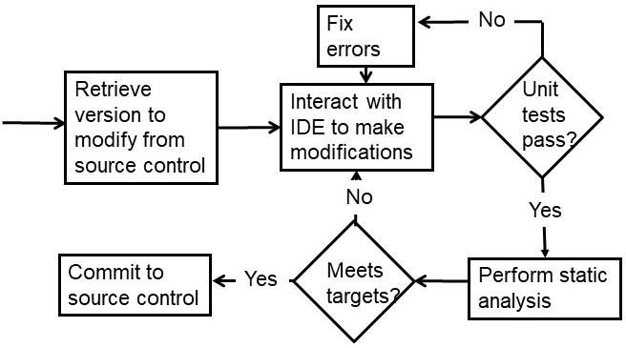
Workflow in development environment

Slide 6
Unit tests
Execution tests include
sunny-day tests conditions
rainy-day tests
regression tests
Tests should be version controlled and saved in the version control repository.

Slide 7
Static analysis
Checks code quality
Looks for particular types of patterns that may be problematic.
Generates false positives
Has severity level settings

Slide 8
Security
A static analyzer can look for known security weakness patterns.
If you package your module as a container, a scanning tool can produce a bill of materials for your container and check it against known vulnerabilities.

Slide 9
Development environment – clean up
Save the VM or container image
Check your module into the version control system.
Record information in the artifact database
The version number of the module being checked in and the version numbers of the tests.
The configuration parameters,
The version of any tools used for testing or static analysis,
The version of the IDE and any plugins used.
All resources used in the development environment should be released.

Slide 10
Discussion questions
Why must all of the unit tests be passed but not all of the static analysis tests?
Sketch a script that performs the “create” step.

Slide 11
Outline
Development environment
Integration environment
Staging environment

Slide 12
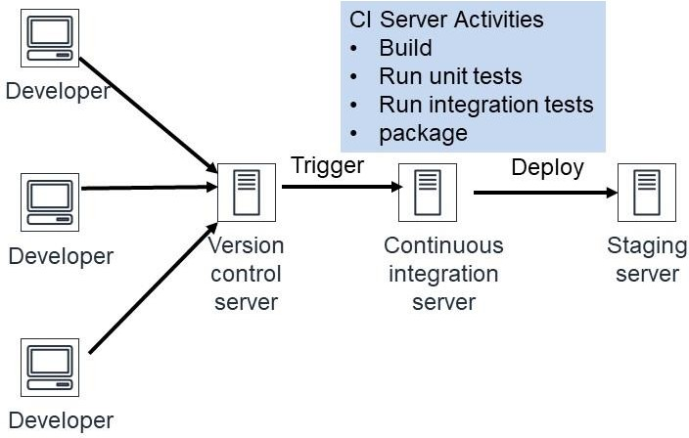
Integration environment – context
The integration environment is where the continuous integration server operates
It is triggered by a commit to the VCS
It builds an executable, runs unit tests, integration tests, and packages a deployable image

Slide 13
Integration environment—create
The Continuous Integration (CI) server requires two virtual machines.
One for the CI server itself
One is the workspace for the CI server.
Populates the test database,
Creates the test harness,
creates a VM with a load balancer,
Sets up the configuration parameters for integration,
Links either to external services or to mocks of the external services.

Slide 14
Integration environment—usage
Build a service. This is performed by the CI server.
Compile and link all the source code for the service
Load all dependencies required by the source ode
Test for functional correctness
Unit tests from all included modules
System wide tests – sunny day, rainy day, regression
Enough tests for sufficient coverage but not so many that the testing takes too much time

Slide 15
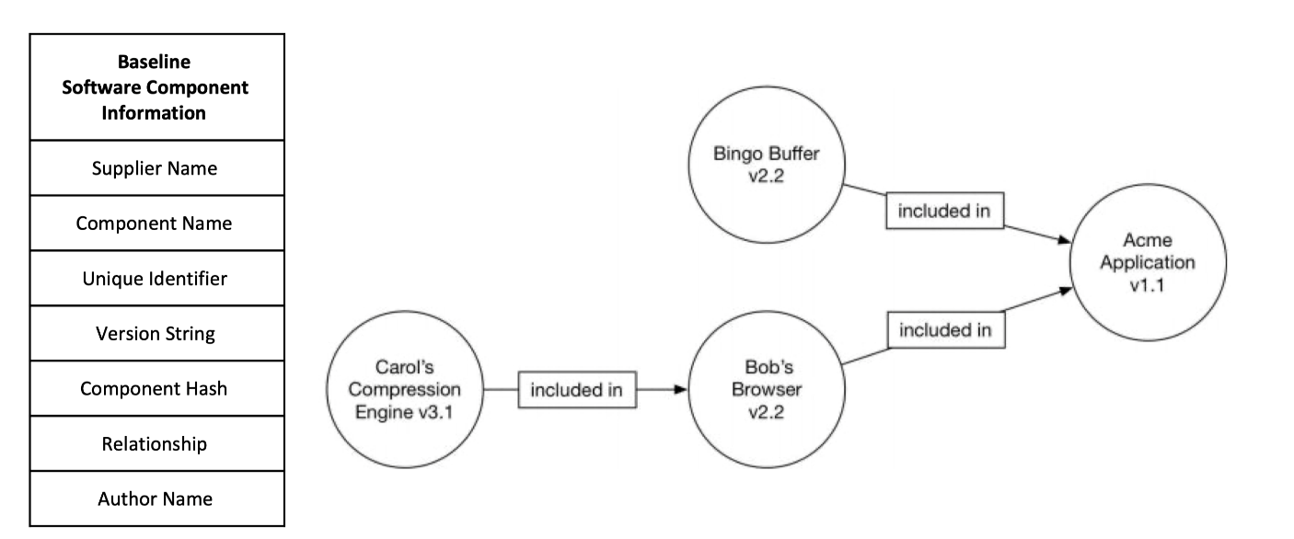
SBOM (Software Bill of Materials)
A Software Bill of Materials (SBOM) is a formal record containing the details and supply chain relationships of various components used in building software
An SBOM identifies and lists software components, information about those components, and the relationships between them.

Slide 16
What is SBOM used for?
Start with CVE (Common Vulnerabilities and Exposures)
This is a list of known vulnerabilities is software
When system is built, check if dependencies are listed in CVE.
Consequently, built system has no known vulnerabilities.

Slide 17
Time passes
When system is built, no known vulnerabilities.
Two months after deployment, a vulnerability may be discovered in one of the dependencies.
How do you know that your system now has a vulnerability?

Slide 18
Monitor SBOM
SBOM lists all dependencies
CVE lists all known vulnerabilities
Periodically (daily), a tool can check the SBOM against the CVE and discover newly listed vulnerabilities.
Log4J had a vulnerability from 2013 until 2021.

Slide 19
Test database
Data in the database should be
Representative of real data
Not too voluminous
Personally Identifiable Information (PII) should be obscured
Data base should be restored to its original state after each test.

Slide 20
Integration environment – clean up
The VM or container with that service is saved for future use.
Record information in the artifact database, including
the location of the service-specific package saved,
The version numbers and source of all the included modules,
The version numbers of all the tests run.
The version of the test tool and the continuous integration server
Configuration parameters
Release resources used by the integration environment.

Slide 21
Discussion questions
How do you obscure PII?
Why are all of the unit tests rerun in the integration step.

Slide 22
Outline
Development environment
Integration environment
Staging environment

Slide 23
The staging environment--overview
The staging environment tests the whole system for its qualities.
performance under load,
Security
other nonfunctional qualities.
The staging environment should be as close to the production environment as practical.
Triggered by the clean up step of the integration environment.

Slide 24
Staging environment—create
The integration environment will create all the VMs or containers for your service that exist in the production environment, so they do not need to be created for the staging environment
Your service in the staging environment should not differ from that created in the integration environment.

Slide 25
Staging environment—create
The configuration parameters created for the staging environment should be the same as the production environment, with a few exceptions:
Use a separate staging test database
Use credentials appropriate to the staging environment
Mock any external services that your system writes to.

Slide 26
Database
The database for the staging tests should be a copy of the production database, or a large extract, if the full production database is too large.
When using production data, you must obscure any sensitive or restricted data.

Slide 27
Staging environment—usage
Testing types
Load testing
Security testing
Compliance testing
User testing
The final step in the staging environment is deployment to production

Slide 28
Load testing
Load testing has three portions
Defining the load
Applying the load
Measuring the system’s throughput and/or latency.

Slide 29
Defining the load
The contents of the oad should reflect the distribution of values that you will see in production.
It may be that your system receives mostly one type of request in production,
there may be hotspots in your database
Requests in production is may come in bursts
The number of simultaneous users may increase very slowly, or rapily

Slide 30
Sources for the load
There are three possible sources for the load:
A load-testing tool. A load-testing tool, such as Artillery, generates synthetic loads for systems. You provide the tool with a description of the input and its distribution. The tool generates synthetic loads in accordance with your description and measures the latency of the responses.
Playback. Record input to the production version of the system and use the recording as a source of test input

Slide 31
Sources for the load
3. Tee the input to the production version. “Tee” is a Unix command that takes one input stream and generates two output streams that are identical to the input stream. One branch of the tee will go to the production version and the other to the test version.

Slide 32
Applying the load
Two approaches to applying the load
Load-testing tools, which combine load synthesis with load response.
Build a custom test harness.
Ensure that the software applying the load does not introduce any limits on the request rate during test execution – you want to be sure that you are measuring the performance of your system and not your test harness.

Slide 33
Measuring the system
Challenges to measurement
Accurately handling long-tail latency. This leads to running tests that execute so many requests that it is not practical to save the results of every request, and so the measurement framework must build latency histograms and calculate metrics on the fly.

Slide 34
Measuring the system
The heterogeneous performance delivered by the underlying hardware in the cloud. Some of the physical computers may be slow because of disk or network-hardware issues, or some may have newer processors that deliver better performance. Your performance testing should cover enough time and enough physical hardware to ensure that you are accurately predicting your system’s performance in production.

Slide 35
Runtime security testing
.OWASP (Open Web System Security Project) is one tool vendor that focuses on vulnerabilities in web systems.
pen (penetration)-testing tools. They test not only for web-facing vulnerabilities but also for vulnerabilities in other portions of the stack. These types of tools are used during the staging environment to perform runtime security testing on your system.

Slide 36
Static analysis
Static analyzer tools examine the source code and look for insecure patterns of usage.
Model checking is a technique that involves symbolically testing all possible paths of a system.
Specify an error condition and the model checker will determine whether that condition can ever occur in your service.

Slide 37
Static analysis
Model checkers suffer from state explosion caused by trying to symbolically execute systems that are too large. Model checking has been applied on systems up to 10,000 lines of code and, thus far, have primarily been used for operating-system and device-driver functions.

Slide 38
Compliance testing
Test for conformance to regulations and license provisions
This is also done using static analyzers.
regulation compliance
license compliance

Slide 39
Regulation compliance
Different types of regulations impose different requirements on how your system handles data.
For example, HIPAA (Health Insurance Portability and Accountability Act) imposes a requirement that sensitive data be protected.
Other domains have their own regulatory requirements and specialized static analyzers can help determine whether the particular requirements are being met.

Slide 40
Regulation compliance
A static analyzer can examine the code, see if regulated data has been properly identified and highlight how it is protected. An analyst can then examine the highlighted code and determine whether the HIPAA security requirement is being met.

Slide 41
License compliance
Each type of open-source license allows you to do different things.
A static analyzer can look at all the source code included in your system and check the system’s license against a set of rules established, probably, by the legal department of your organization.

Slide 42
User testing
The user-facing portion of your service must be tested to be sure it is acceptable to users.
This may involve having actual users execute the system – a form of canary testing.
It may also involve testing how the user interface is displayed on different devices.
Common problems are inaccessible links and buttons and poor color contrast.

Slide 43
Deployment to production
Once your system has passed the tests that occur in the staging environment, the executable– whether packaged as a VM or a container–should be placed on a server for deployment into production. It may be deployed automatically, or a human may be required to authorize the deployment depending on your domain and your organization’s policies.

Slide 44
Staging environment—clean up
The final step in the staging environment is to release the resources used.
As before, artifact information is recorded in the artifact database. This information includes the URL of the testing database, the version of any tools used in this stage, and the settings of configuration parameters.

Slide 45
Discussion questions
What are the top three OWASP security vulnerabilities?
Sketch the design of a license compliance tool.

Slide 46
END OF PART 2 OF CHAP 11

